Slide 1




NEXT GEN EMPLOYABILITY PROGRAM
Creating a future-ready workforce
Team Members
College Name
Student Name :BHARANI DARAN S
Student ID :au622021104016
Paavai college of engineering
namakkal

Slide 2

CAPSTONE PROJECT SHOWCASE
Project Title
Building Bus Reservation System using Python and Django
Abstract | Problem Statement | Project Overview | Proposed Solution | Technology Used | Modelling & Results | Conclusion

Slide 3
Abstract
Project Setup -Start by setting up a new Django project. Make sure you have Python and Django installed on your system.
Database Design: Design the database schema for your bus reservation system. You'll need tables/entities for buses, routes, schedules, reservations, users, etc. Utilize Django's built-in ORM (Object-Relational Mapping) to define your models.
Bus Management: Create views and forms to allow administrators to manage buses, routes, schedules, etc. This includes adding, editing, and deleting bus information.
Reservation System: Implement functionality for users to search for available buses based on their preferred route and date. Allow users to reserve seats on a selected bus.
Source :

Slide 4
Problem Statement
User Authentication:
Users should be able to register for an account and log in securely.
Only logged-in users should be able to make reservations.
Seat Selection:
Users should be able to view available seats for a particular bus route.
Seats should be displayed in a visually understandable layout, allowing users to select seats easily.
Once a seat is selected, it should be marked as unavailable for other users.
Source :

Slide 5


Technology Used
Front-end
Back-end
Source :

Slide 6
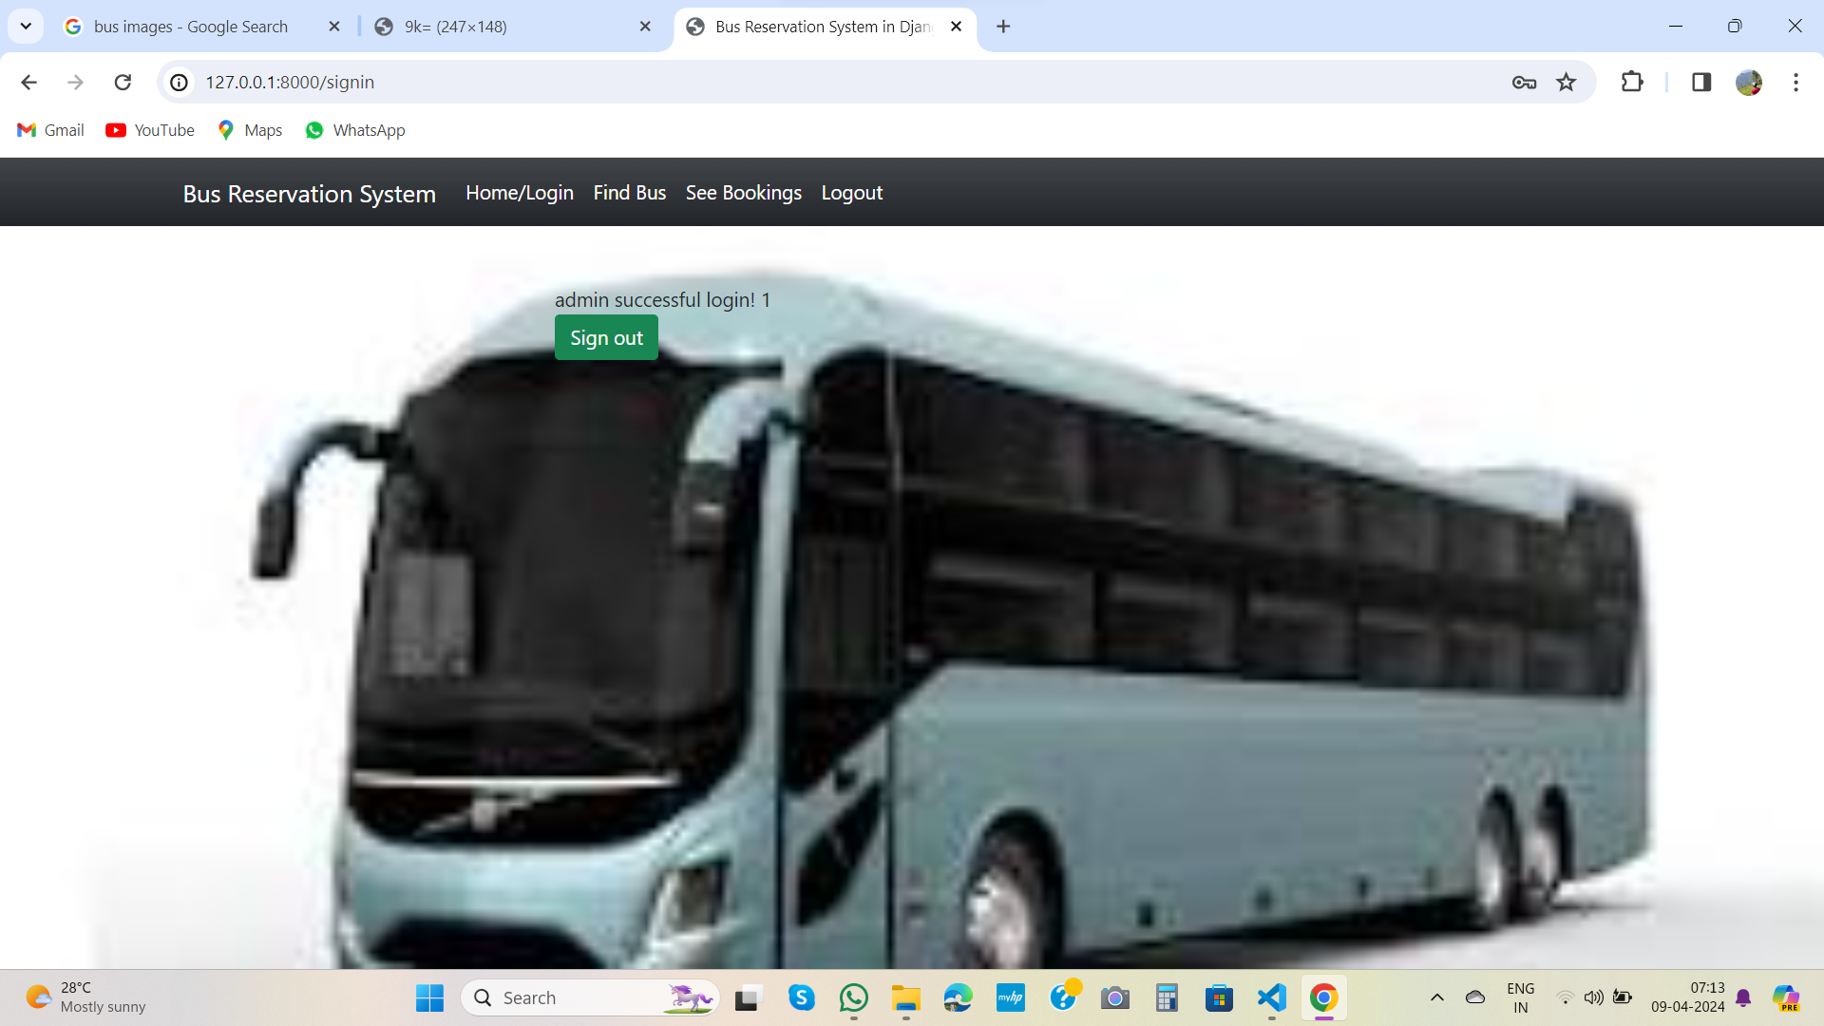
Admin page
Source :

Slide 7
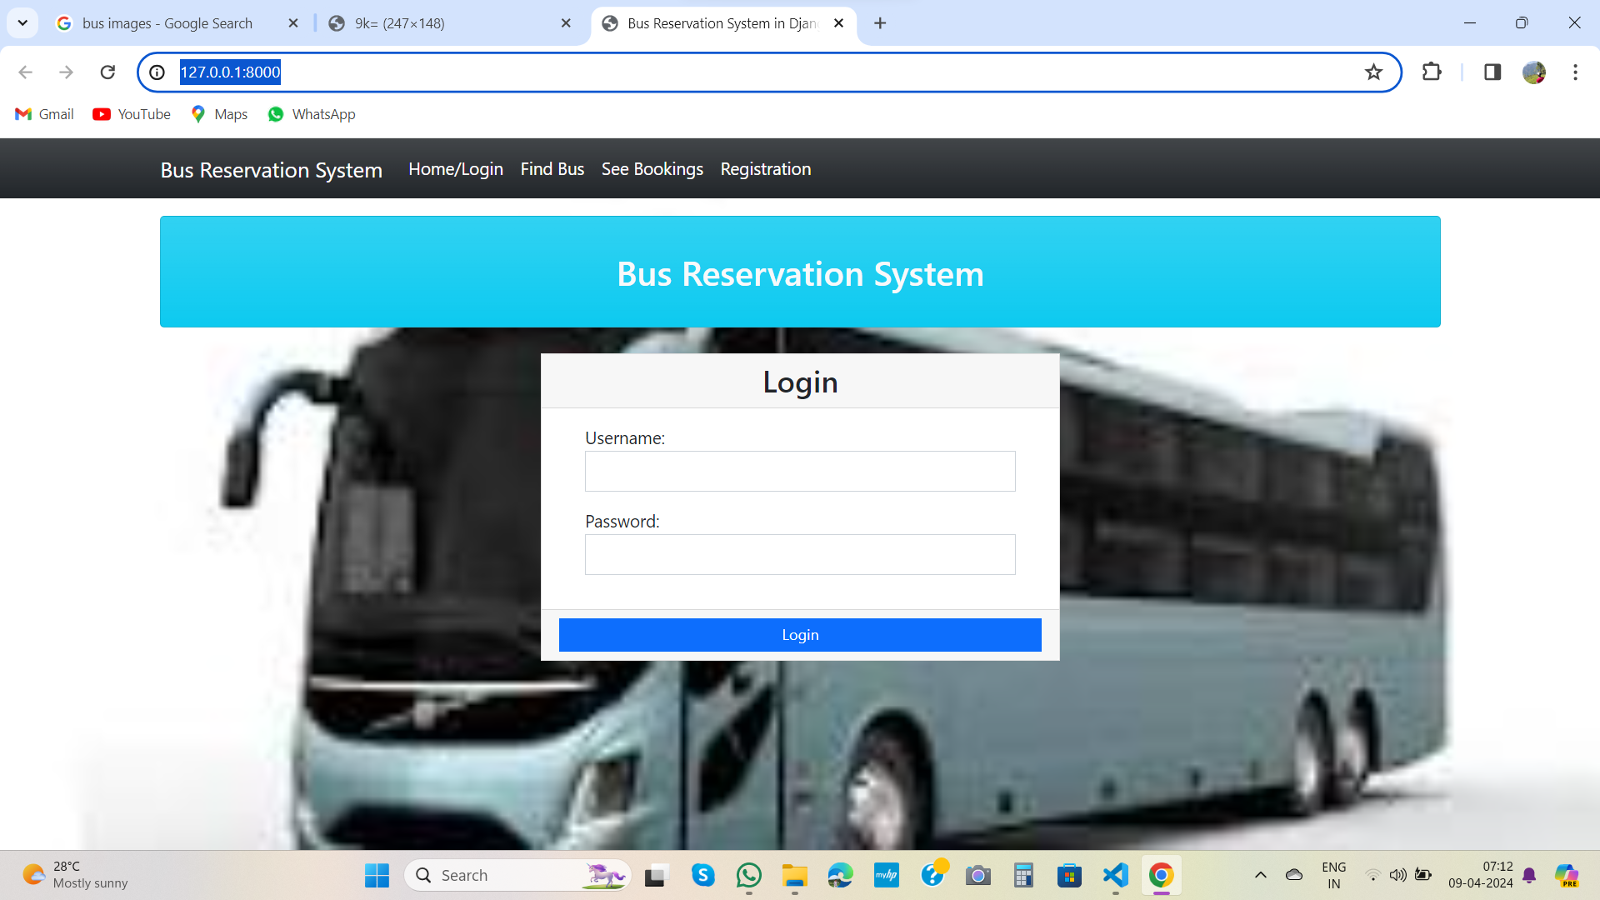
Homepage

Slide 8
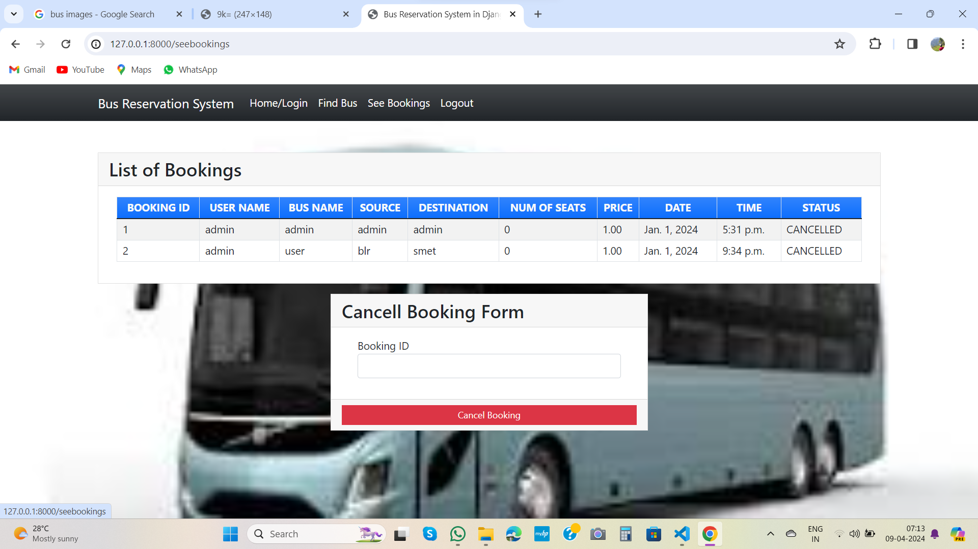
Bus booking-Page

Slide 9
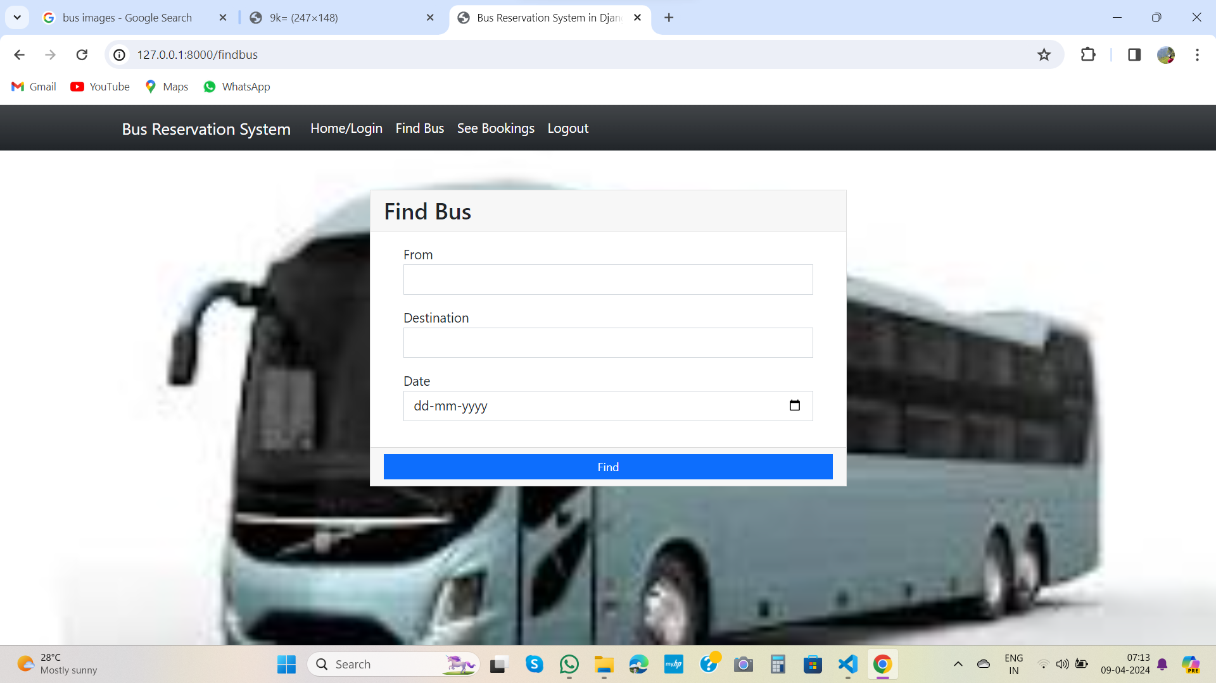
Find -Page

Slide 10
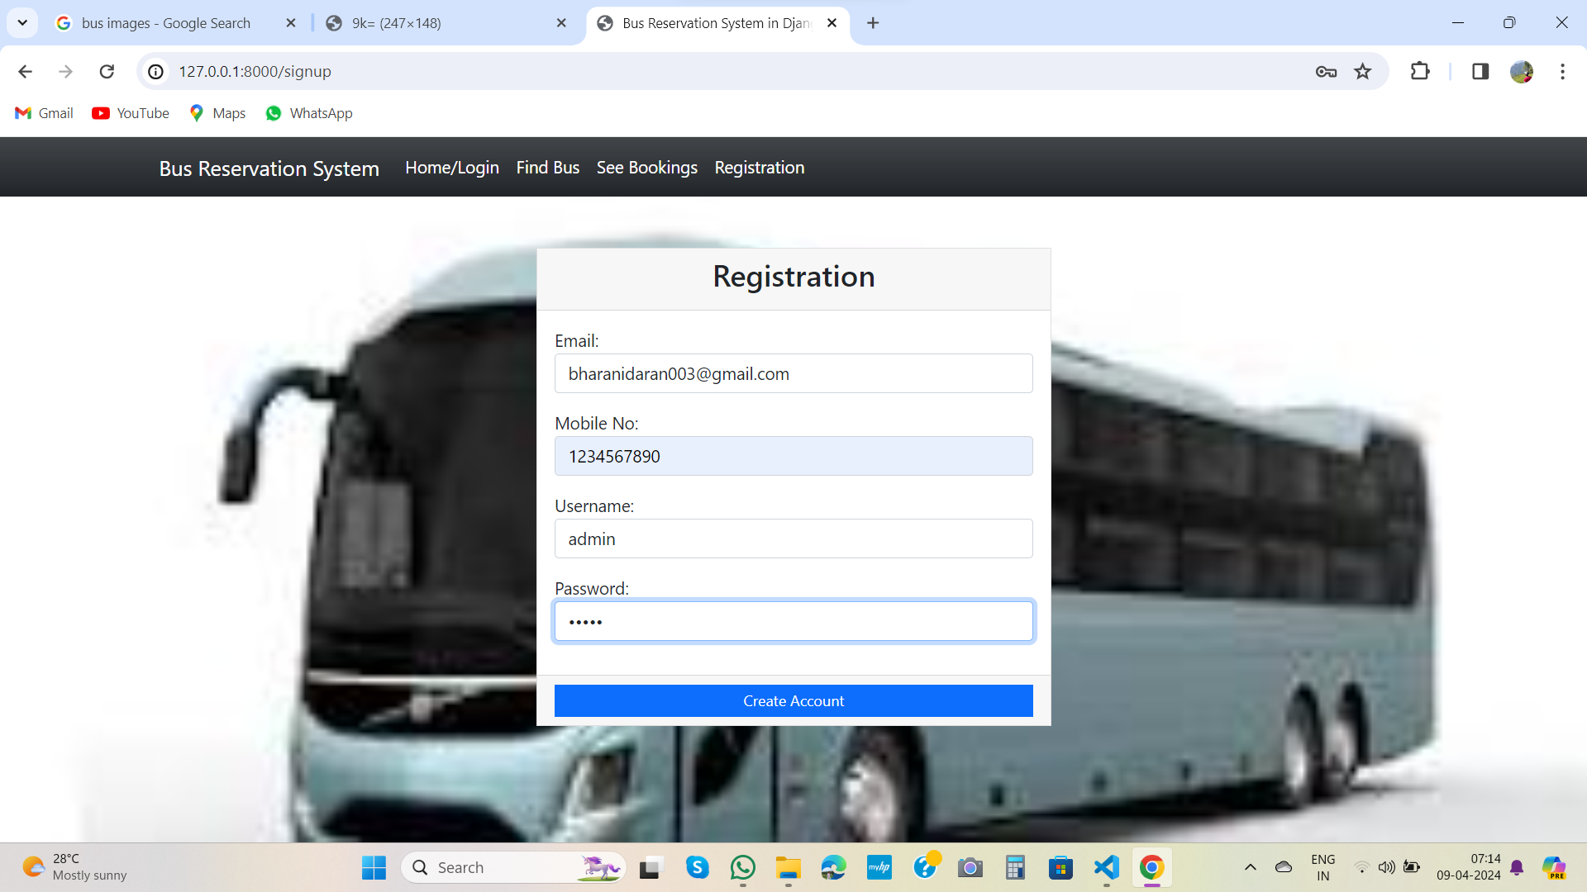
regestration-Page

Slide 11
Thank You!
Notes:
Thank You !!

